Slide 1
Kiwi website
Presntation

Slide 2
Table of contents
01
02
03
04
Introduction
code
.us
.intro about the web site
.The languages and the .framework used
The website
Conclusion
.Screen shots
.ressources
.ending sentence

Slide 3
01
Introduction

Slide 4

—denis waitly
“Time and health are two precious assets that we don’t recognize and appreciate until they have been depleted.”

Slide 5

kiwi!
When it comes to building a vitamin routine, it’s all about your goals, your body, and your lifestyle. Our website makes personal recommendations and evolve them as you progress.
So basically after taking the quiz
You get your Personalized vitamins with a cool packaging

Slide 6
Kiwi pages
home
shop
Landing page
Different category of the product
cart
login
Shopping cart
form

Slide 7

02
code

Slide 8
Languages used:
Html 5
Css 3
*Structuring web page.
*style and layout web pages.
Bootstrap 5
js
*a Framework to makes responsive web design .
*Adding interactive behavior to some elements.

Slide 9
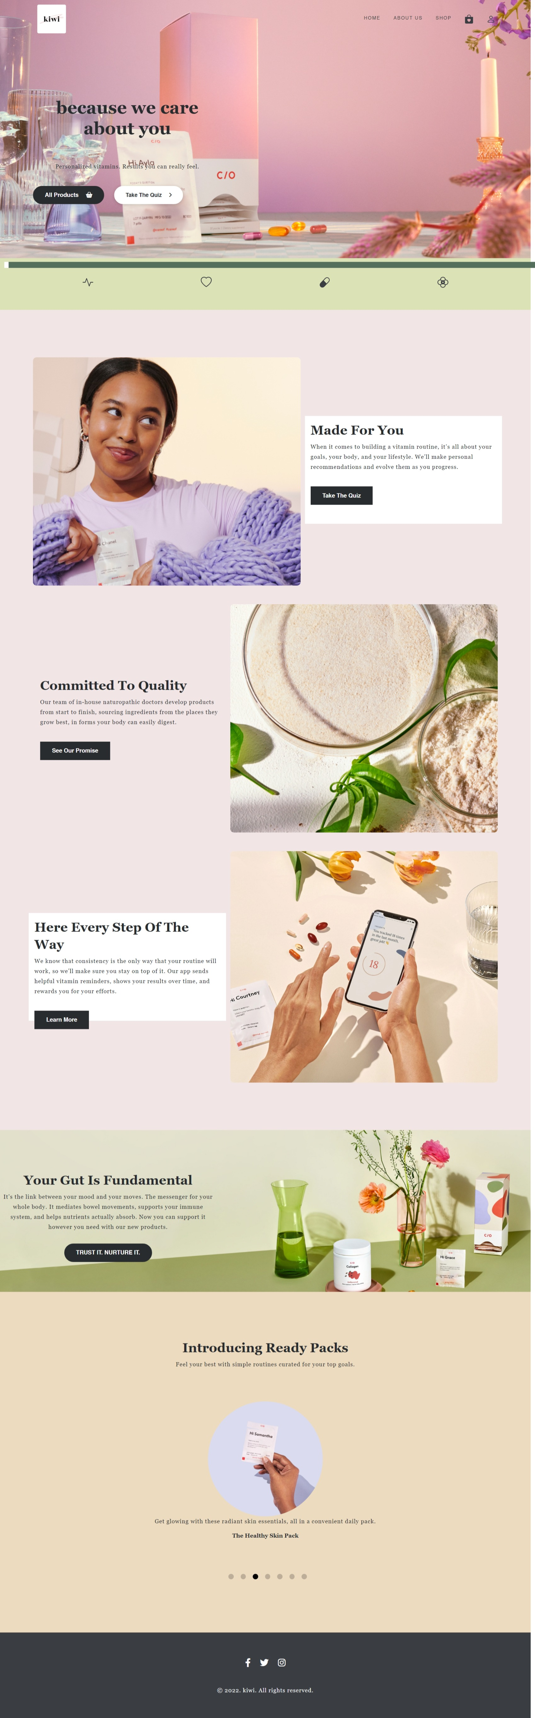

03 the web site
Screen shots

Slide 10
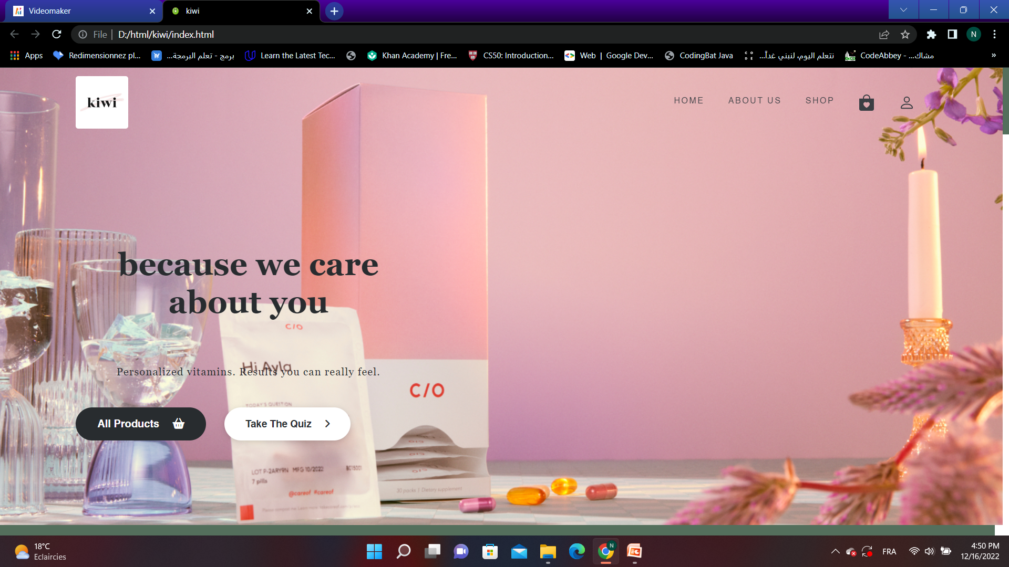
Home:

Slide 11
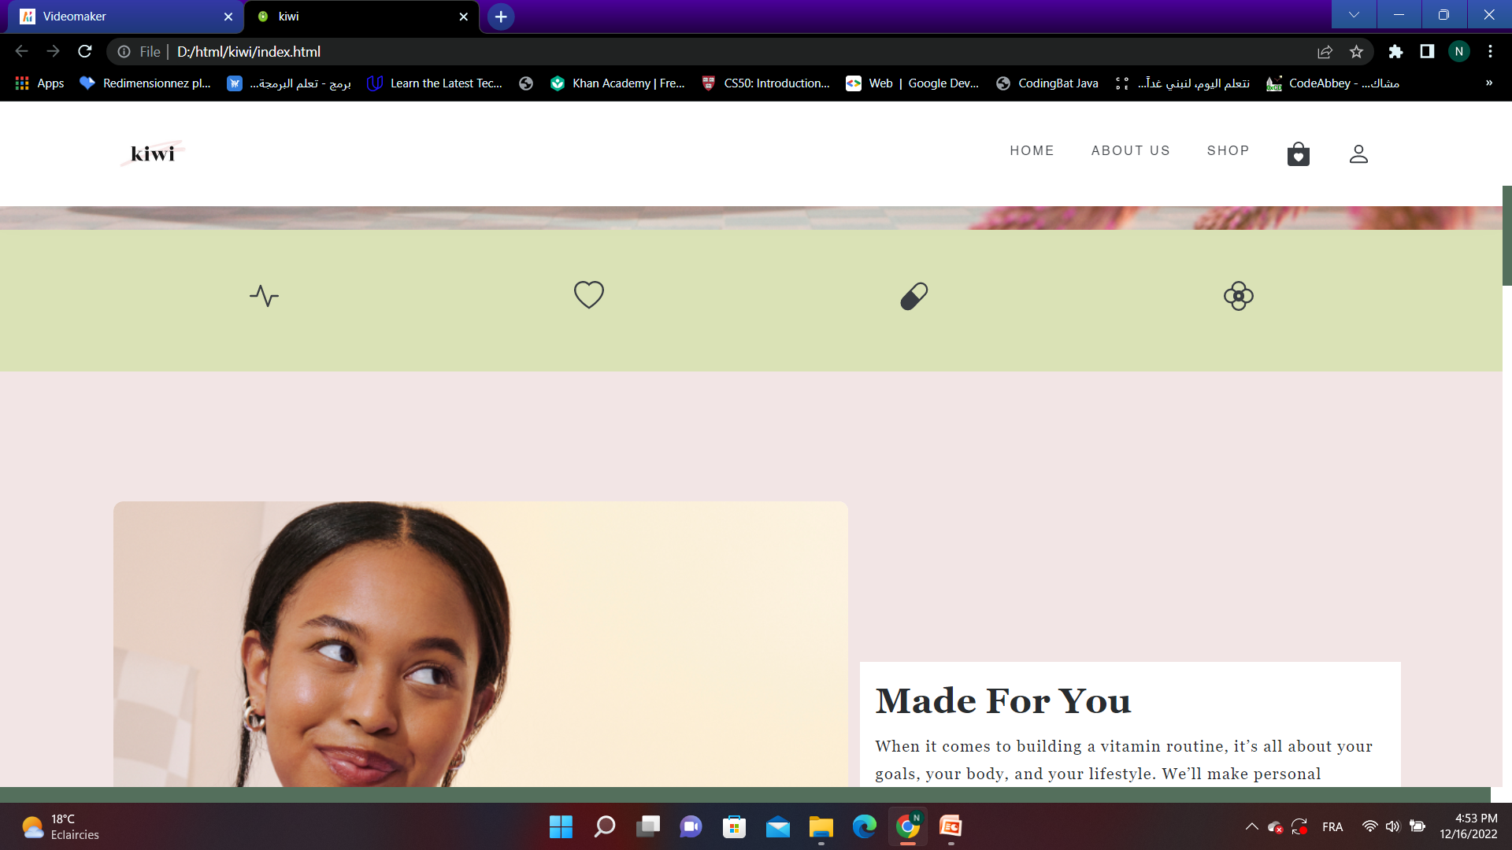

Slide 12
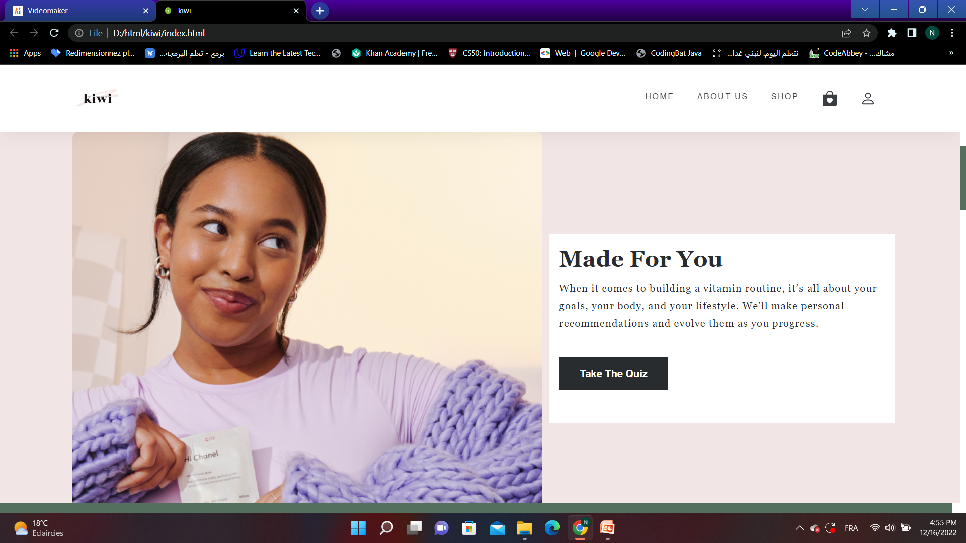

Slide 13
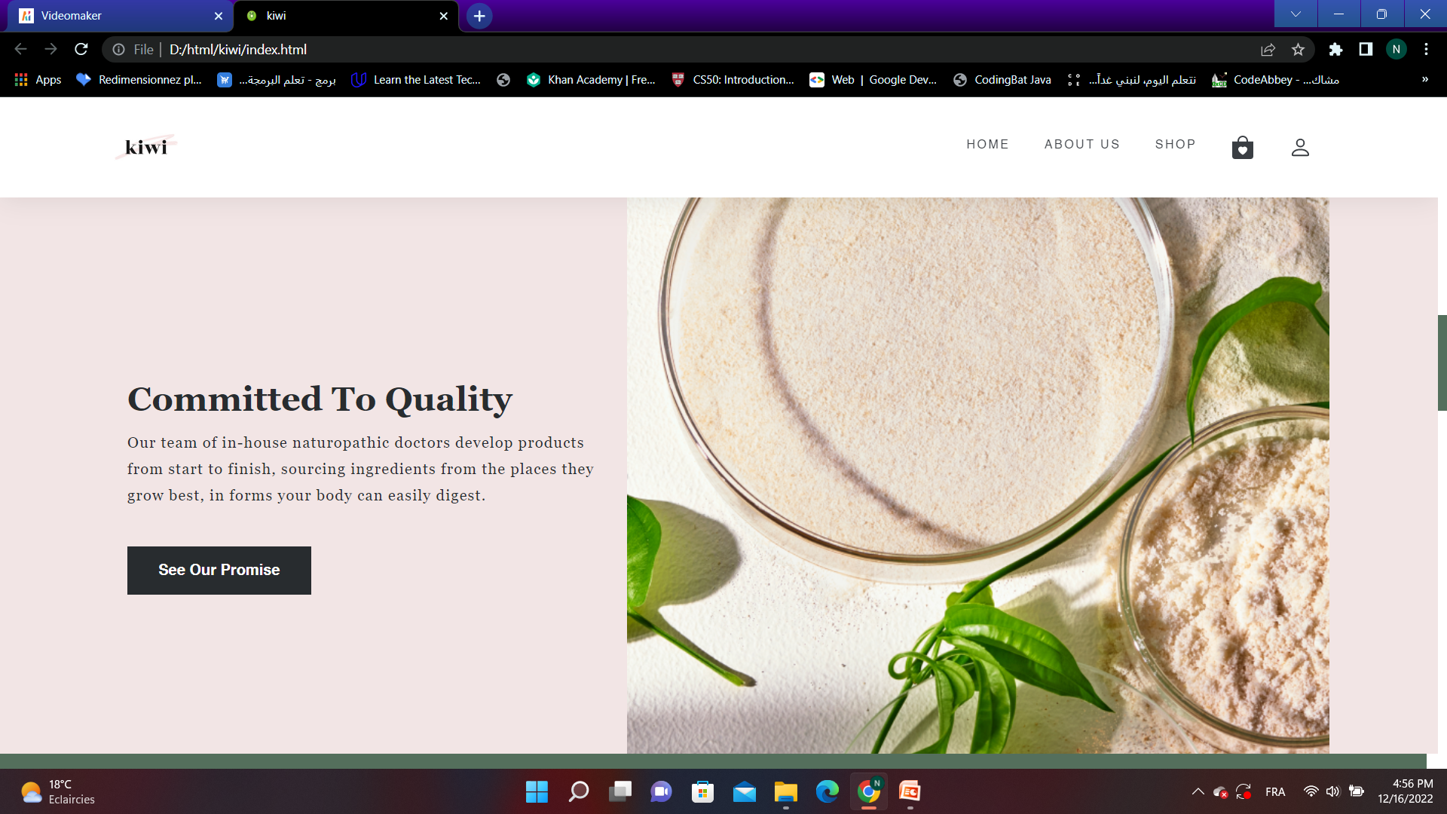

Slide 14
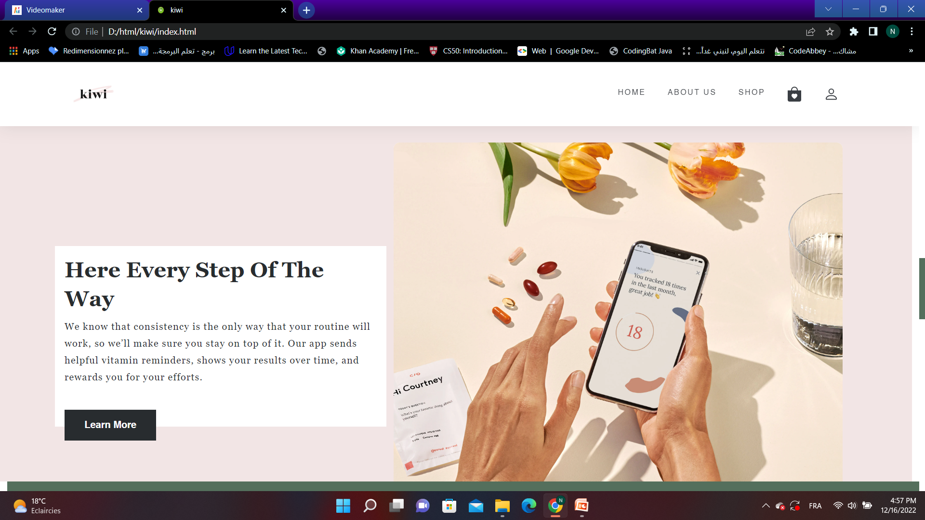

Slide 15
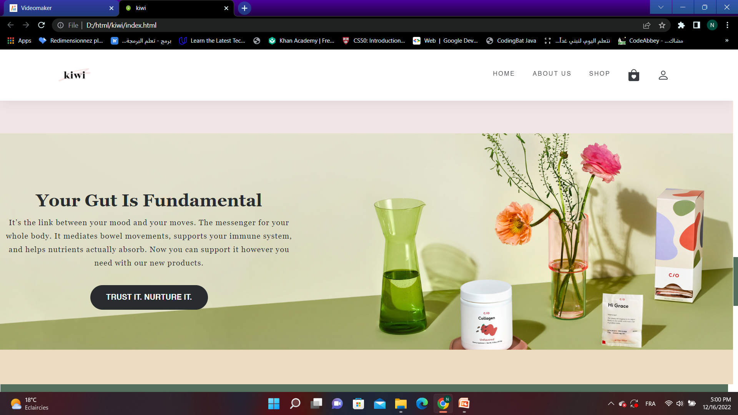

Slide 16
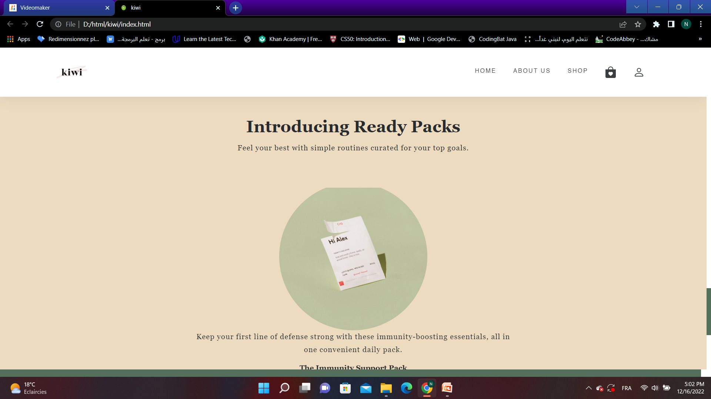

Slide 17
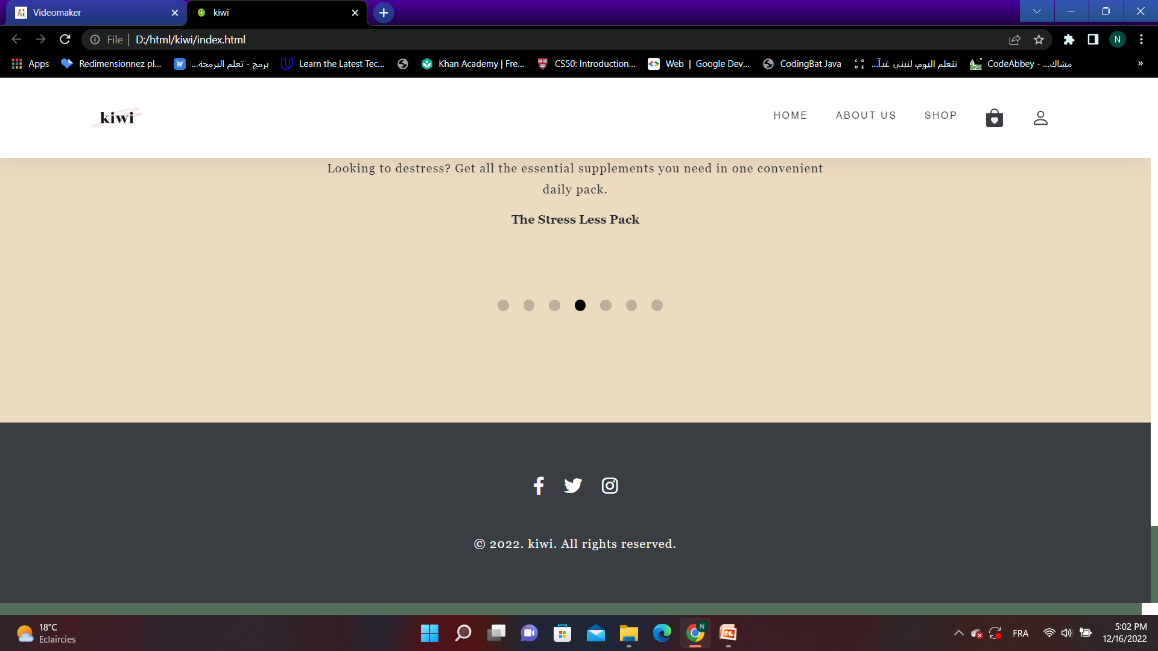

Slide 18
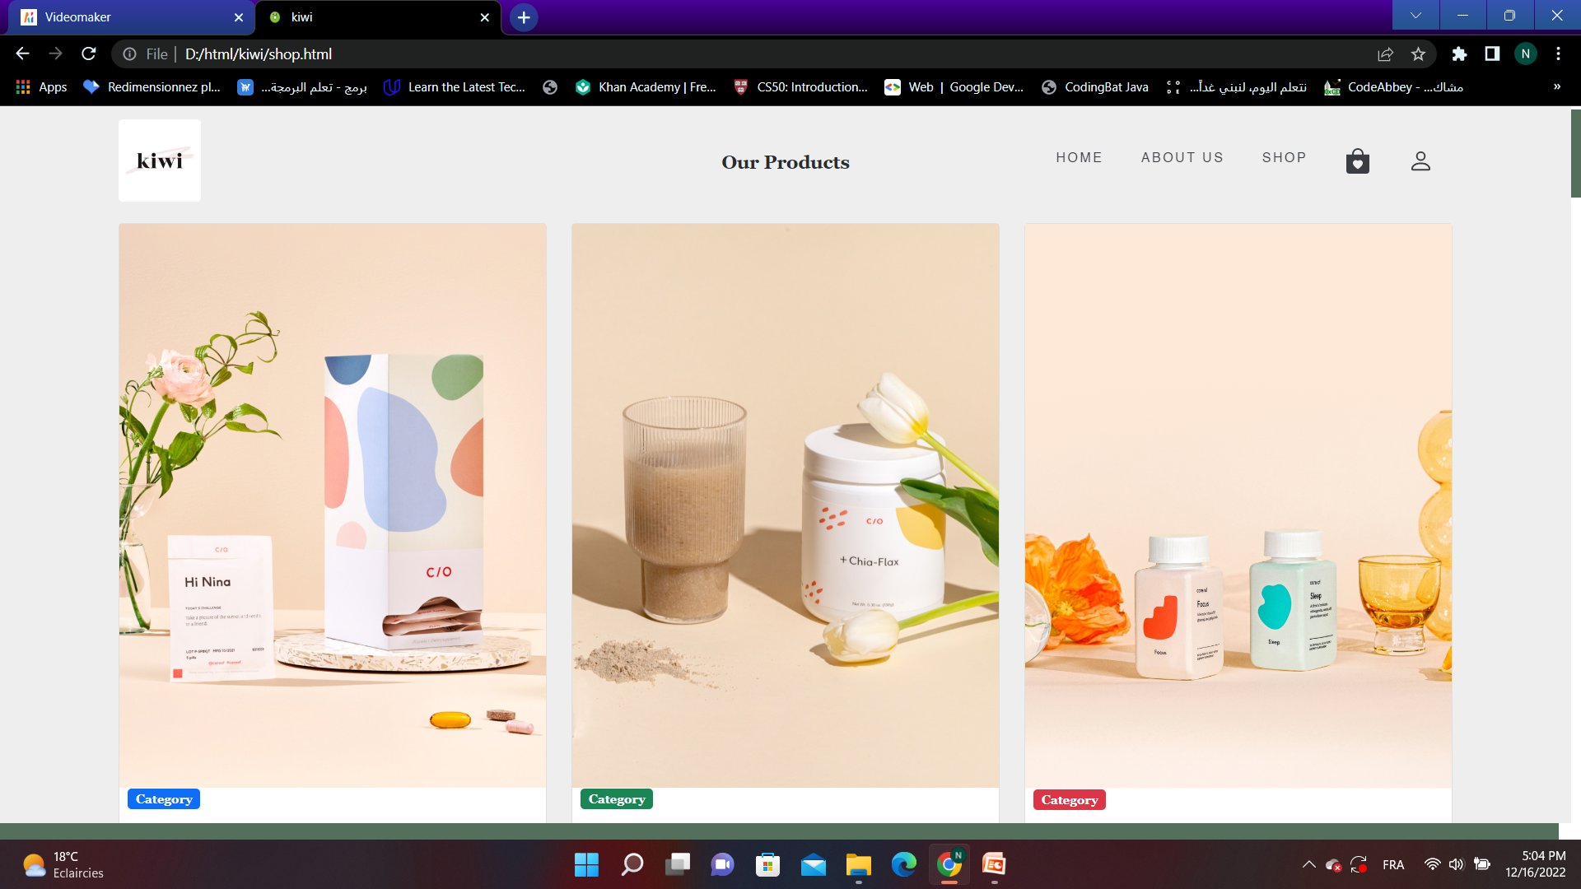
Shop:

Slide 19
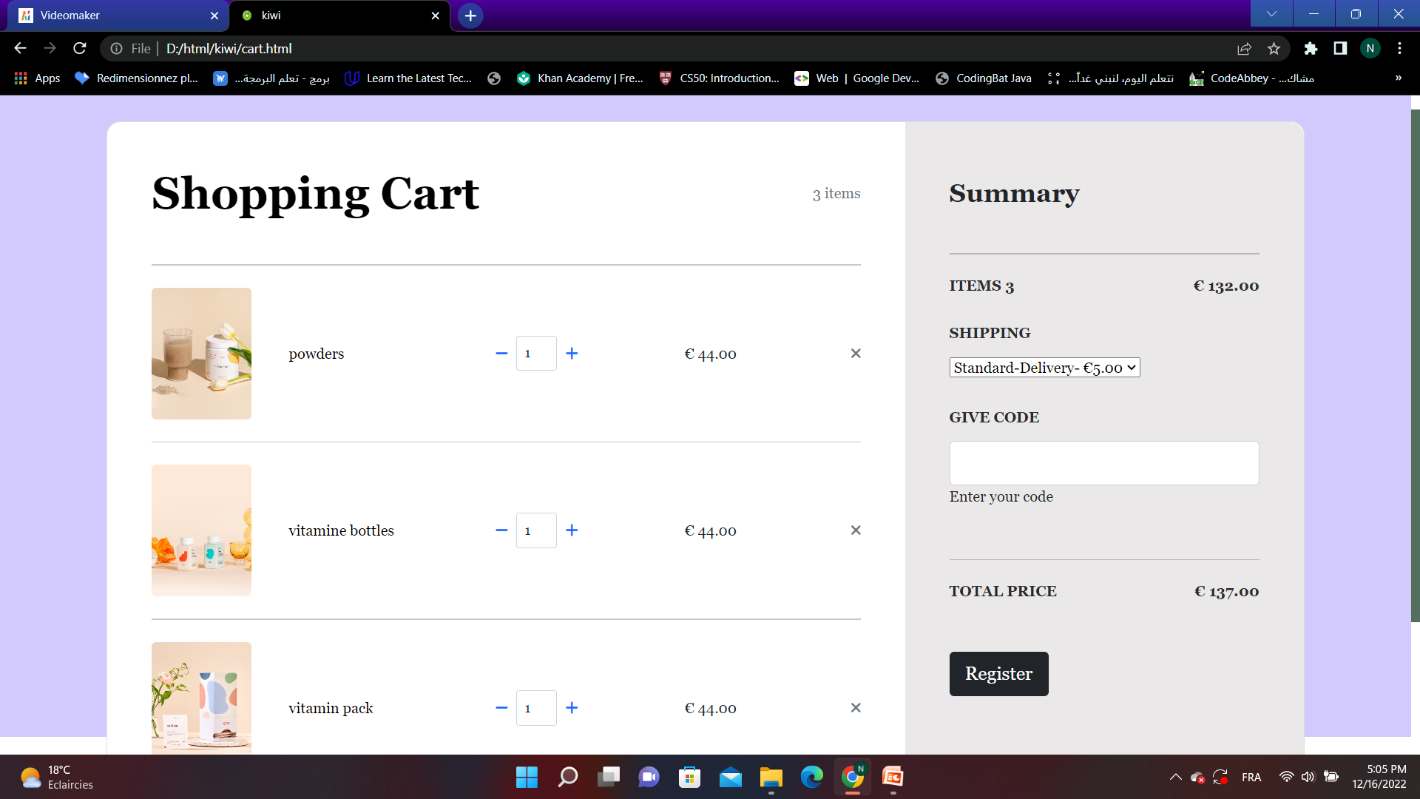
Cart:

Slide 20
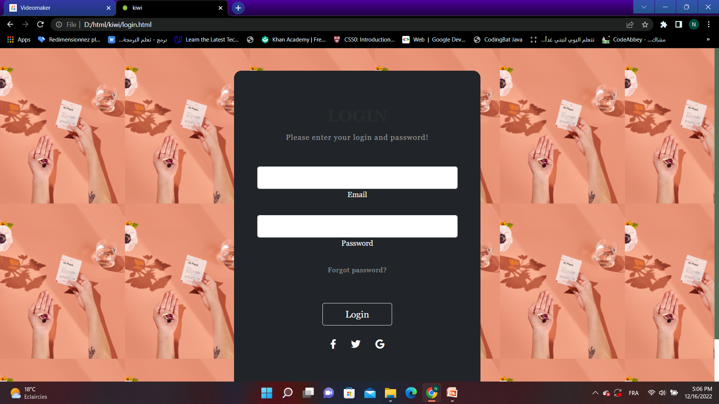
Login:

Slide 21

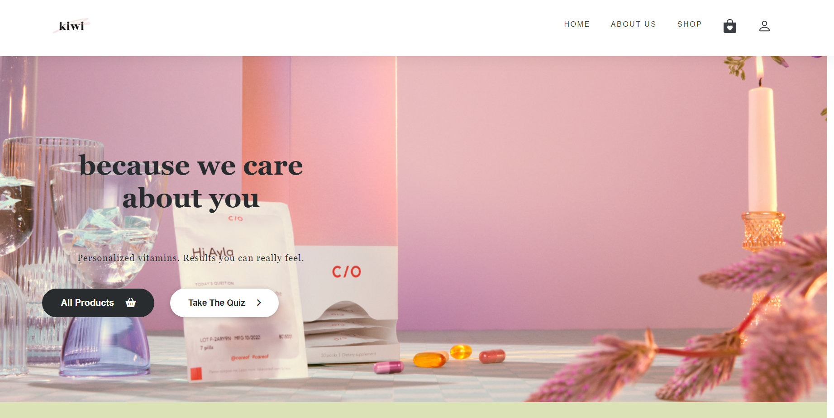
Desktop software

Slide 22
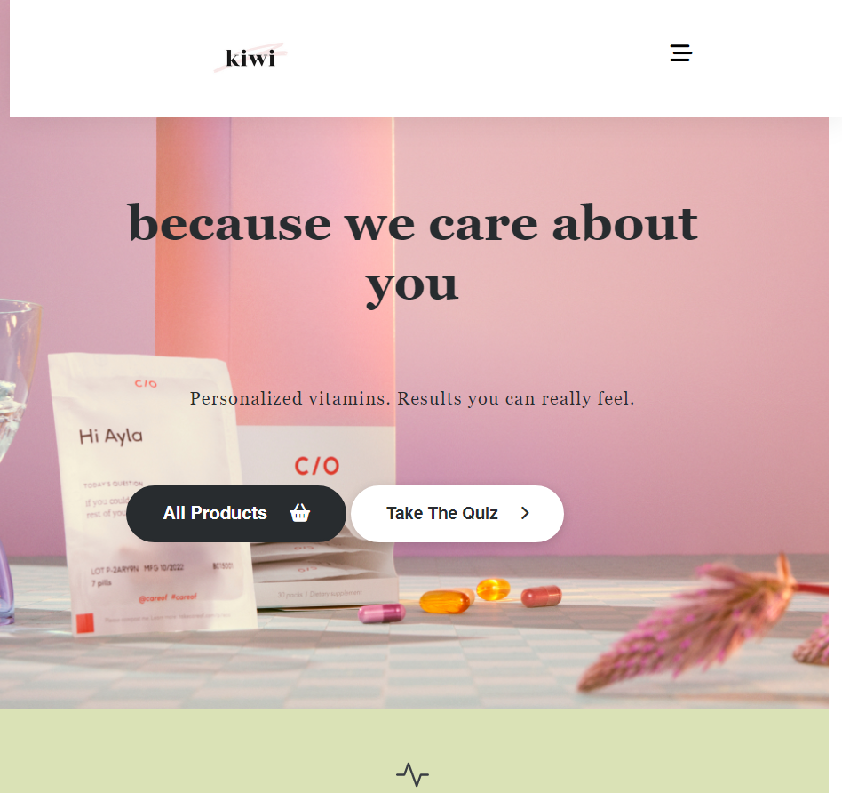
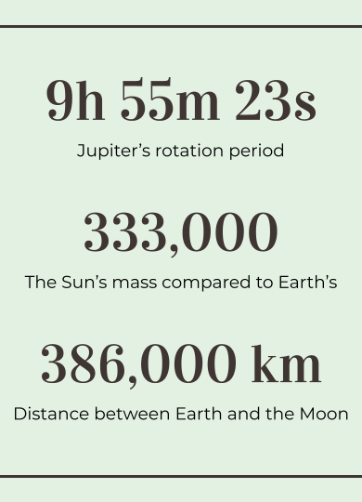
Tablet app

Slide 23
04 conclusion

Slide 24
resourses
w3school
youtube
tutorial
Designs ai
google
Ai video
For img
Icones
bugs solving
I used care of for inspiration and color co for the palette

Slide 25

click>>>>>

